Slide 1
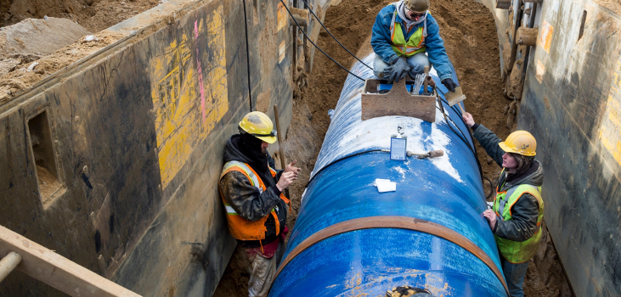

FINANCIAL RESOURCES
AND BEYOND

Slide 2

Water Infrastructure and Resiliency Finance Center
The Water Finance Center is an information and assistance center, helping communities make informed decisions for drinking water, wastewater, and stormwater infrastructure to protect human health and the environment.
Research
Advise
Innovate
Network
www.epa.gov/waterfinancecenter

Slide 3
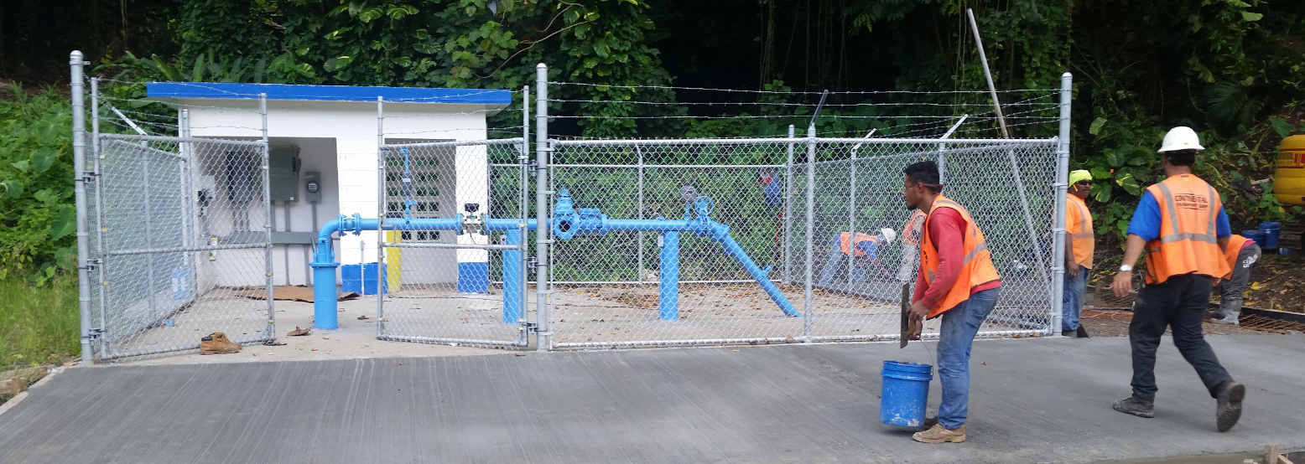
Sustainable Communities and Infrastructure Branch
EPA’s Small Communities and Infrastructure Branch’s mission is to promote sustainable management and technological advancement of wastewater systems, both centralized and decentralized, and to provide construction funding to underserved communities.
www.epa.gov/small-and-rural-wastewater-systems

Slide 4
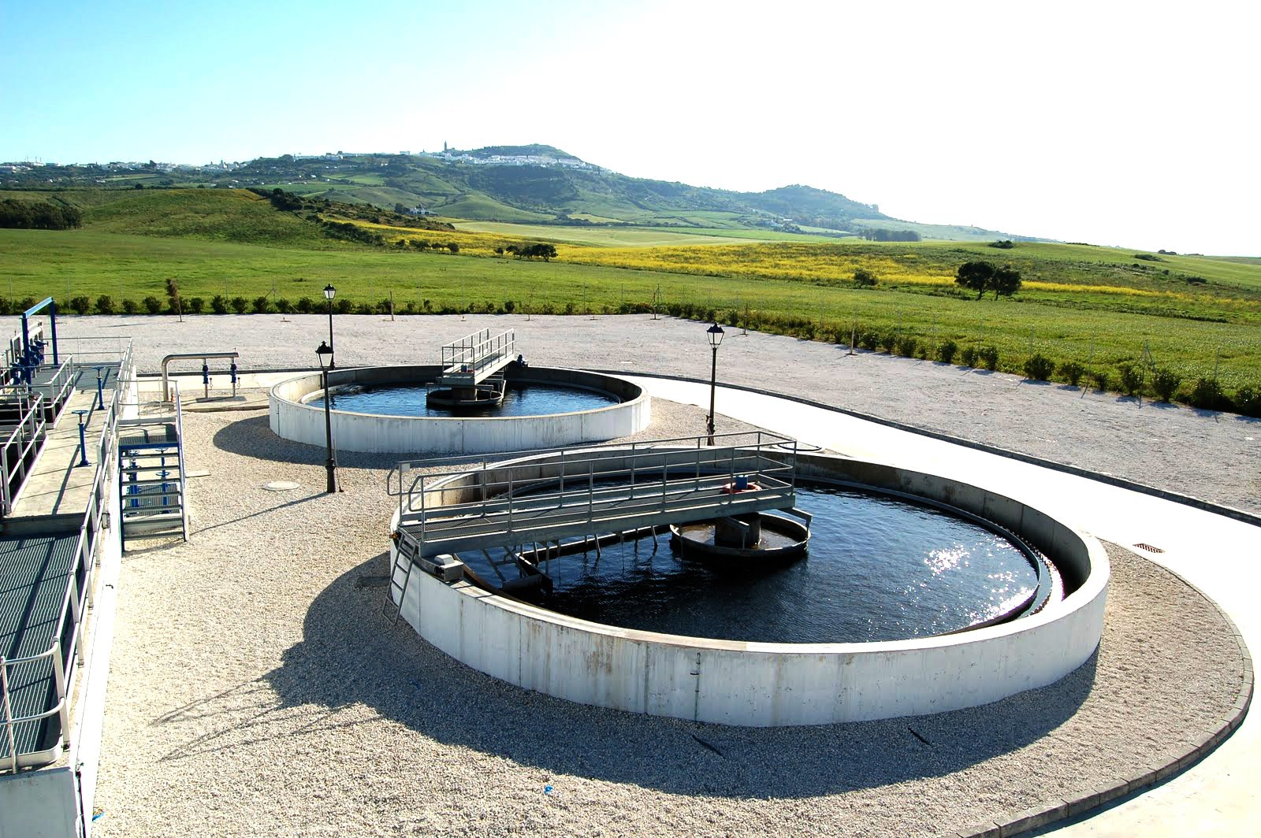
EPA Resources
Funding and Financing
  Funding through targeted grants programs to specific eligible recipients
  Financing through State Revolving Fund (SRF) and Water Infrastructure Finance and Innovation Act (WIFIA) programs
  Resources for utilities and local decision-makers
Training and Technical Assistance
  Training for small and rural wastewater systems
  Effective Utility Management
  Regionalization collaboration
  Water and Wastewater Utility Operation and Management for Small Communities

Slide 5
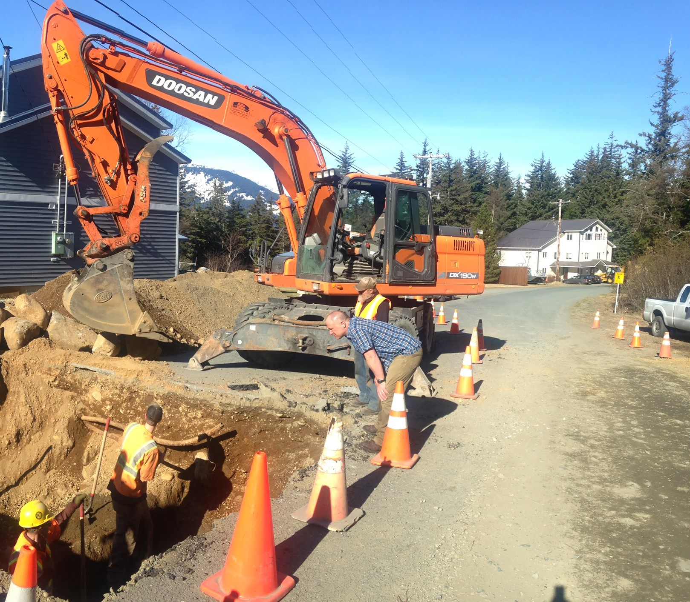
FUNDING AND FINANCING
Providing affordable financing to build water quality projects in communities and identifying new and innovative approaches to financing water infrastructure that help existing dollars work smarter and harder

Slide 6
Target Grant Programs for Communities
Territories and D.C. Wastewater Construction Grants
  Only communities in U.S. territories (except Puerto Rico) and D.C. eligible
Clean Water Indian Set-Aside
  Includes $2 million for technical assistance and training
Alaska Native Villages and Rural Alaska Infrastructure
  Water and wastewater projects eligible
US – Mexico Border
  Water and wastewater projects benefitting US eligible

Slide 7
Clean Water SRF and WIFIA
Clean Water SRF
  Largest water infrastructure funding program
  EPA awards grants to state-managed infrastructure banks
  States select projects and set loan terms
  Eligible projects include POTWs, nonpoint source projects, estuary projects, planning/design, and capital construction
WIFIA
  New water infrastructure federal credit program for regionally and nationally significant water infrastructure projects
  EPA selects projects, sets loan terms, and manages payments
  Projects eligible for SRF also eligible for WIFIA
  Projects must be greater than $5 million for small communities
Notes:
WIFIA
Appropriation serves as credit subsidy (to cover losses); remainder is borrowed from and repaid to Treasury
EPA selects projects, sets loan terms, and manages payments:
interest rates at US Treasury rate
terms up to 35 years from completion
5 year deferment of repayment allowed

Slide 8
Environmental Finance Centers
Environmental Finance Center Network (EFCN) creates innovative solutions to difficult how-to-pay issues of environmental protection and improvement
EFCN works with public and private sectors to promote sustainable environmental solutions while bolstering efforts to manage costs
Focus:
  Protecting natural resources and watersheds by strengthening the capacity of local decision-makers to analyze environmental problems
  Develop innovative and effective methods of financing environmental efforts
  Educate communities about role of finance and economic development in environmental protection

Slide 9


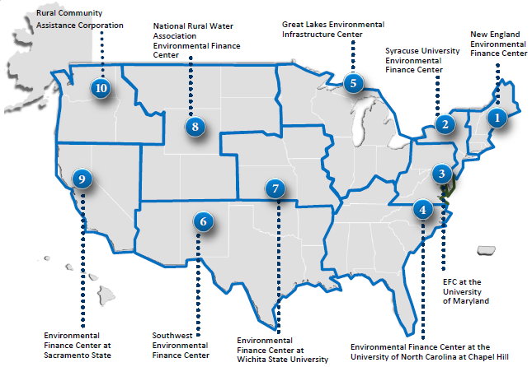

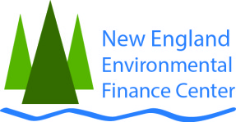





Notes:
The Southwest Environmental Finance Center at University of New Mexico has done work on water loss.

Slide 10
Environmental Financial Advisory Board
Environmental Financial Advisory Board (EFAB) provides ideas and advice to EPA on ways to lower costs of and increase investments in environmental and public health protection
EFAB's work focuses on:
  Lowering the cost of environmental protection
  Removing financial and programmatic barriers that raise costs
  Increasing public and private contribution in environmental facilities and services
  Building state and local financial ability to meet environmental laws

Slide 11



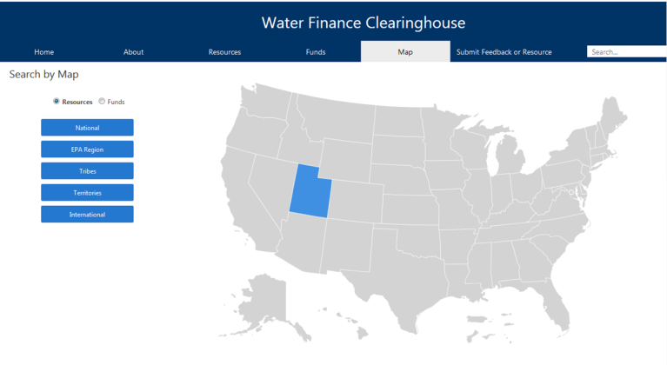
WATER
FINANCE CLEARINGHOUSE
Meeting the Needs of Key Stakeholders
The Water Finance Clearinghouse is an easily navigable web-based portal that helps communities locate information and resources that will assist them in making informed decisions for their drinking water, wastewater, and stormwater infrastructure needs.
www.epa.gov/wfc
Notes:
Communities have to search multiple websites and cumbersome databases to identify funding and financing options for their water infrastructure projects. Communities, especially those that are small, cannot afford to commit time and resources to finding the information they need.

Slide 12




EPA’s Water Finance Clearinghouse
ALL ON ONE SITE
UPDATE IN REAL TIME
SEARCHABLE
MODERN & EASY TO USE
Coalesce all funding information – federal, state, local, etc., into one online database
Design can be maintained throughout the year
Users should be able to narrow their search results to meet their needs
Easy to navigate and have a modern look to inspire confidence in the user that the site is up-to-date

Slide 13
Types of Clearinghouse Accounts
GENERAL USERS
CONTRIBUTORS
Users interested in:
Favoriting resources and funding sources for quick access at any time
Subscribing to receive email updates for new additions/edits to specific filters options
Users interested in editing or adding information to the Clearinghouse
Contributors can suggest:
  Edits to existing information in the Water Finance Clearinghouse
  Additions of new resources and/or funding sources
  Removal of resources and/or funding sources

Slide 14
Clearinghouse Content
Funding/Financing Sources
  Current federal, state, local, private, or other sources of funding/financing for water infrastructure projects
  Searchable by eligible recipient, location, system size, funding/financing source, and more
Resources
  Reports, websites, trainings, and other types of information about water infrastructure financing
Learning Modules
Wastewater Technology

Slide 15
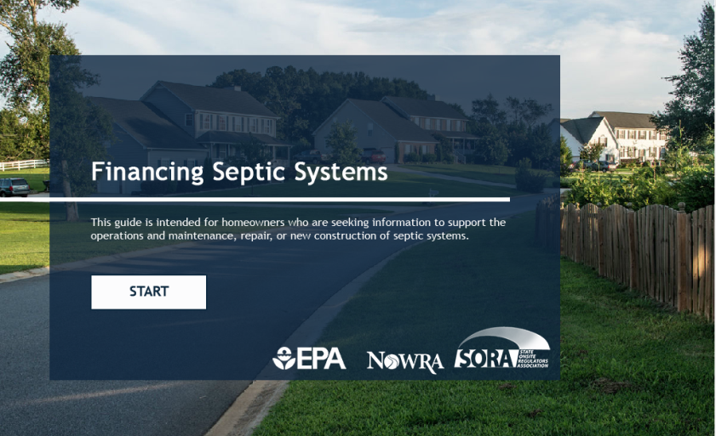
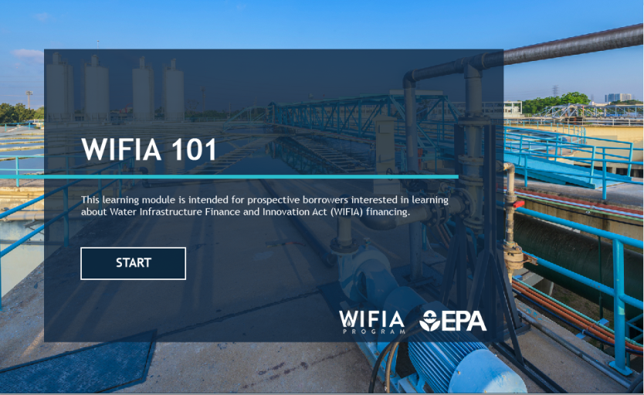
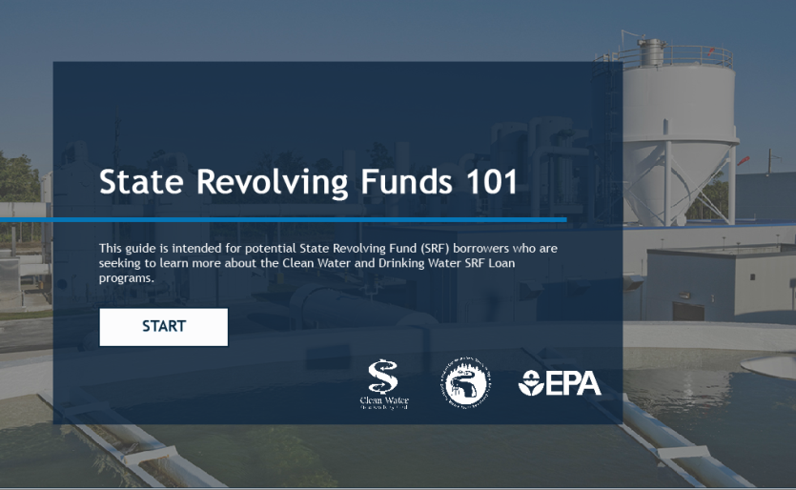
CLEARINGHOUSE
LEARNING MODULES
The Water Finance Center is developing step-by-step interactive guides on specific water finance topics that will be housed in the Water Finance Clearinghouse.
Launched:
  WIFIA 101
  Financing decentralized wastewater systems
  SRF 101
Future Topics:
  Alternative project delivery
  Water loss financing
  Disaster recovery and resiliency financing for water and wastewater utilities
  Stormwater financing
  Financing municipal watershed partnerships with agriculture

Slide 16
Wastewater Technology Clearinghouse
Technology Clearinghouse
  AWIA Section 4102 mandates EPA to set up a wastewater technology clearinghouse to update and disseminate information on cost effective and alternative waste water treatment technologies including onsite and decentralized wastewater systems
  Phase 1: Update existing alternative technologies webpage and add technology component of Water Finance Clearinghouse
  Next phase: Outreach to non-profit organizations, utilities, academia, and States to improve the Clearinghouse and invite them to become contributors
  Goal: To create a discussion platform for individuals to ask questions and assist others with engineering and design challenges (Community of Practice)

Slide 17
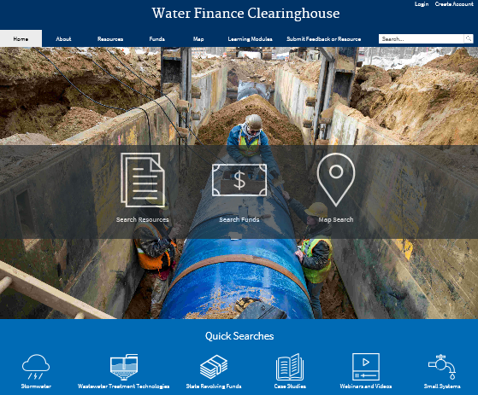

Slide 18
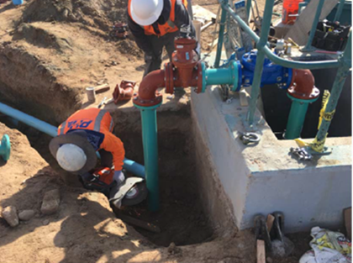
TRAINING AND TECHNICAL ASSISTANCE
Promoting best practices, technical assistance, guidance, and training to help states, industries, and communities make informed decisions about managing water resources.

Slide 19
Small Wastewater Systems Outreach and Education
EPA Grants for Training and Technical Assistance for Small Systems
  EPA and its partners developed tools and resources for planning, designing, constructing, and maintaining wastewater infrastructure for small and rural communities
  AWIA authorized new additional grant funding specifically for technical assistance to small, rural, and tribal POTWs
Sustainable Water Management/Effective Utility Management Workshops
  EPA works with 6 national organizations supporting drinking water and wastewater utilities to promote effective utility management practices
  EPA, with USDA, developed the Rural and Small Systems Guidebook and Workshop in a Box

Slide 20

Targeted Technical Assistance
Clean Water Indian Set-Aside Tribal Technical Assistance and Education
  Interagency agreement with Indian Health Service to support onsite technical assistance and education
Decentralized Systems
  Memorandum of Understanding with 17 partner organizations
  SepticSmart Week
Wastewater technology experts providing assistance to states on issues relating to nutrients, emerging contaminants, water reuse, and more

Slide 21
EPA and Regionalization
Partnerships provide opportunities to:
  Increase system capacity by working together to solve compliance challenges
  Share costs of operations and maintenance activities
  Leverage other resources
EPA meets with stakeholders across water sector to discuss ways to address challenges, focusing on three key priority areas:
  Incentives for partnerships
  Funding and financing
  Outreach and communication
EPA continues to work with states to raise awareness and promote partnerships

Slide 22
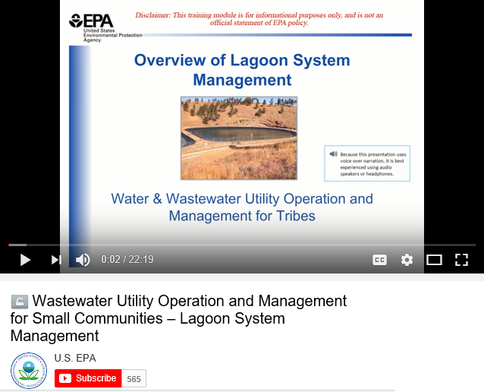
Water and Wastewater Utility Operation and Management for Small Communities
Overview of Lagoon System Management
  What a lagoon is and why they are used so frequently across US
  Different lagoon and wastewater pond classifications as well as how these lagoons function
  Performance of wastewater lagoons and how we can evaluate that through sampling and laboratory analysis
  Main operation and maintenance tasks for operators of wastewater lagoons
Notes:
Series of presentations on operation, maintenance, and management of water and wastewater utilities serving Native American Tribes and Alaskan Native Villages

Slide 23
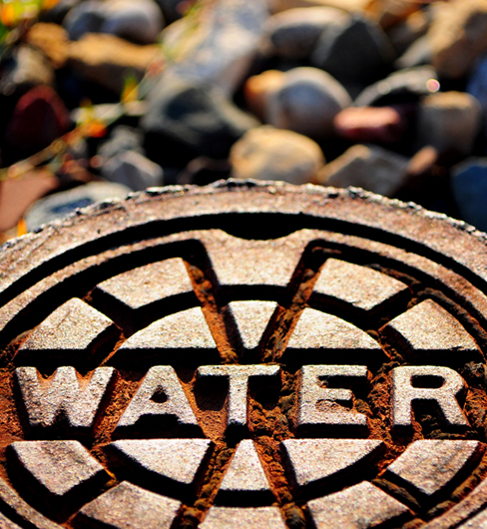

Find Us Online
Water Infrastructure and Resiliency Finance Center
www.epa.gov/waterfinancecenter
Water Finance Clearinghouse
www.epa.gov/wfc
Small & Rural Wastewater Systems
www.epa.gov/small-and-rural-wastewater-systems
Email
waterfinancecenter@epa.gov

